Slide 1
Please get your test folders from the back of the room. Clean out team folders.

Slide 2
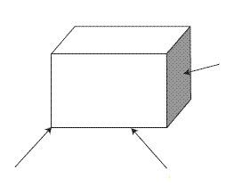
Vocabulary Definitions
A
C
B

Slide 3
Book Definitions
Face: A flat surface | Edge: Intersection of two or more faces | Vertex: A point where 3 faces meet Does a cone have a vertex?
Bases: A pair of parallel and congruent faces and sides that dictates a 3D objects shape.

Slide 4
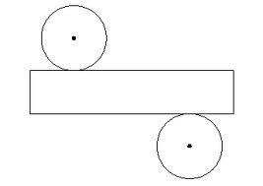
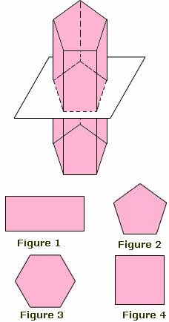
A
B
Cross Section: A shape made from the intersection of a figure with a 2D plane.
Net: The 2D model of a 3D figure

Slide 5
Types of Figures
Prism A 3D figure formed by 2 parallel polygonal bases connected by faces that are PARALLELOGRAMS Real life: | Cylinder A 3D figure with 2 parallel circular bases and a curved surface that connects them Real life:
Pyramid A 3D figure formed by a polygonal base connected by TRIANGULAR faces that meet at a common vertex. Real life: | Cone A 3D figure with one circular base connected by a curved surface. The top portion is called the fulcrum, the “vertex” is called the apex. Real life:

